Slide 1
Data Flow in Medical Imaging
By Justin Rainey
Purdue University Global
10/26/2023

Slide 2
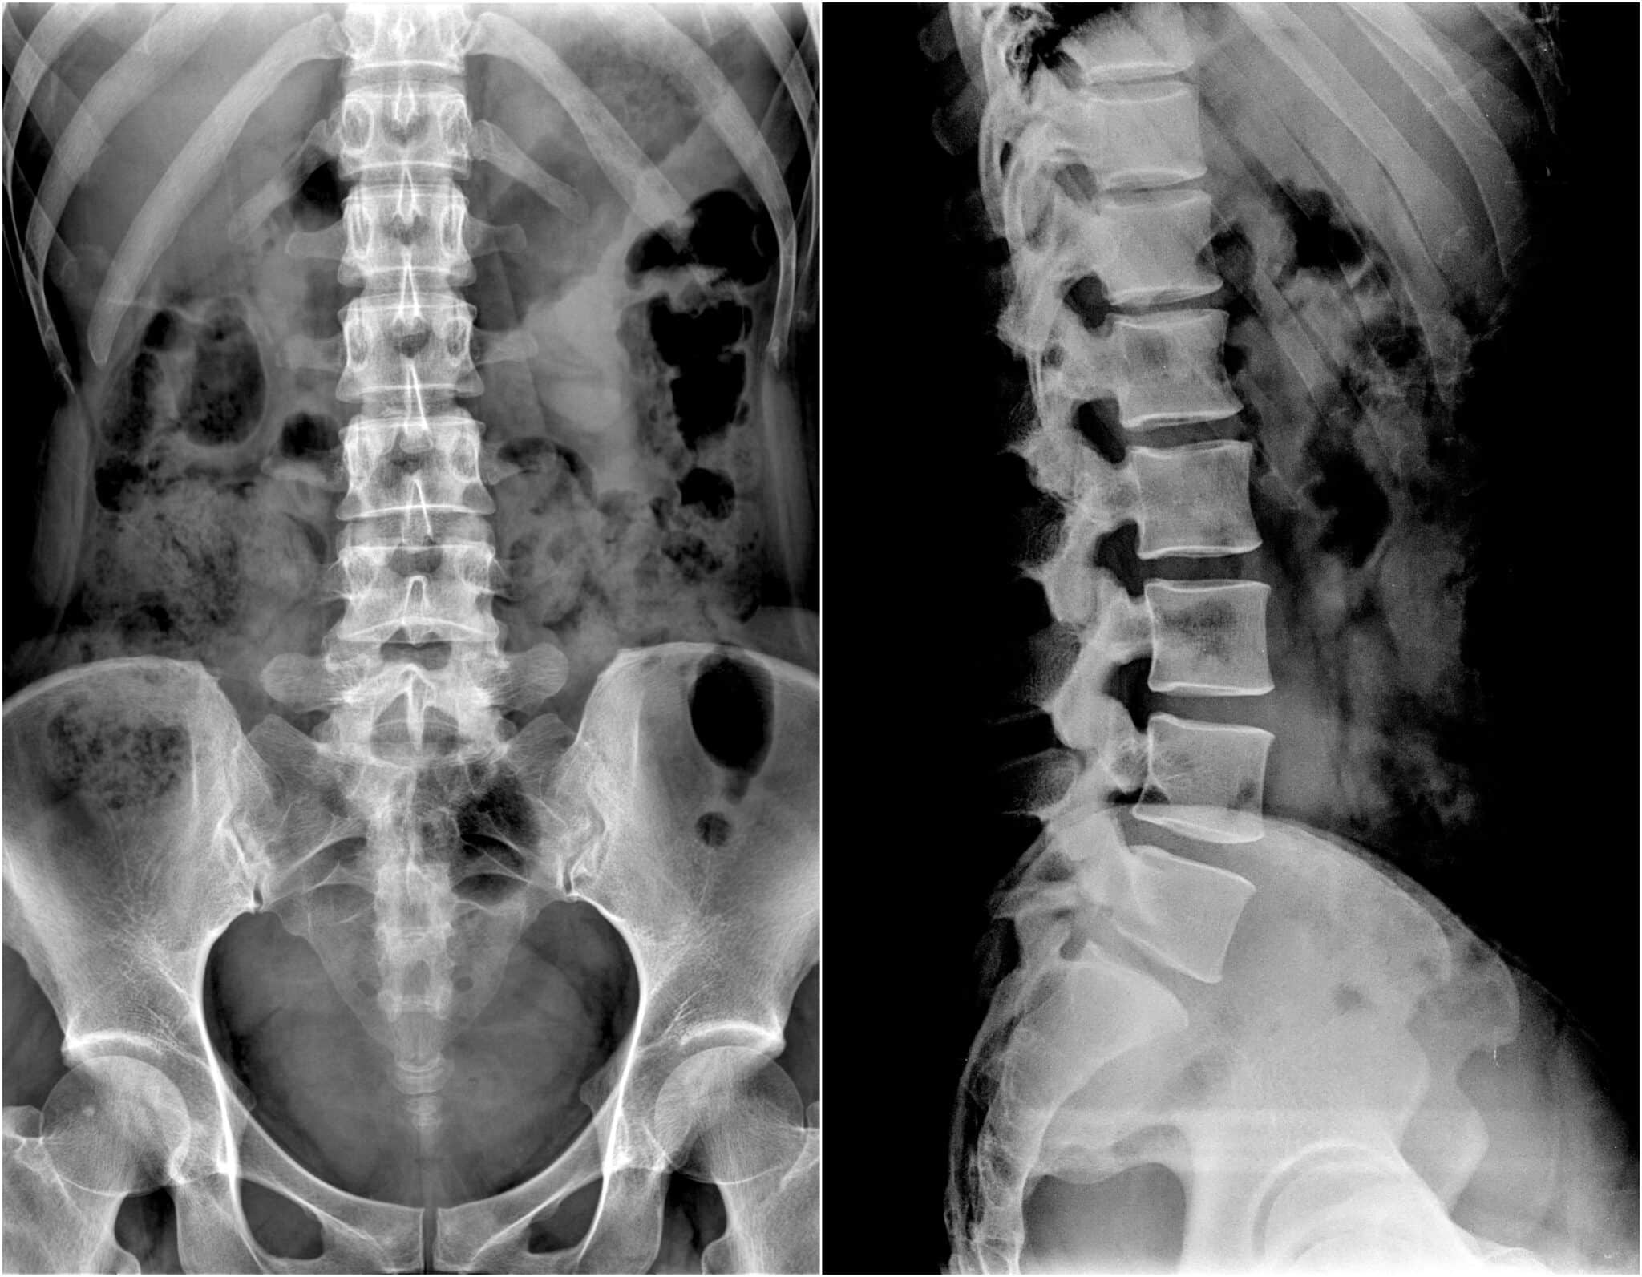
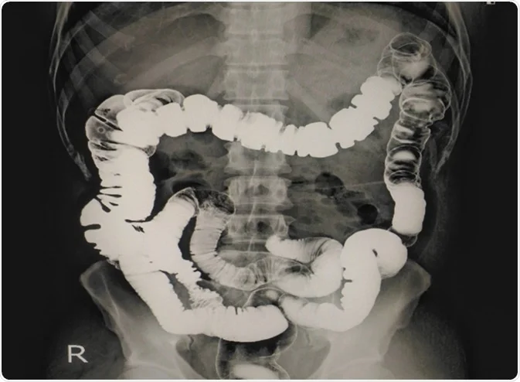
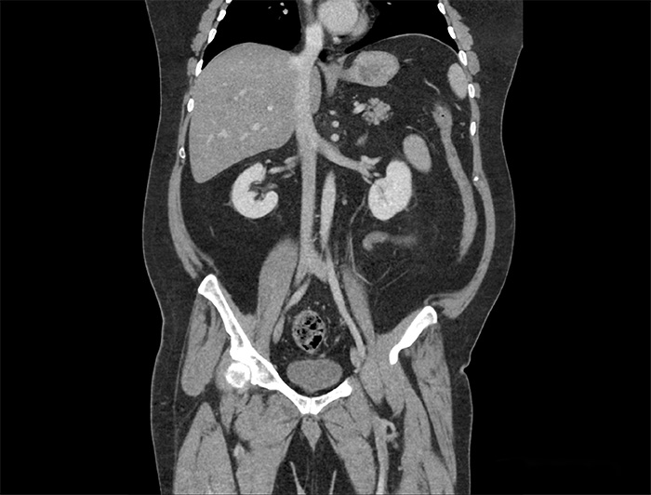
Medical Imaging is performed in several modalities, each optimal for diagnosing specific diseases or conditions
X-ray – great for seeing bones
Fluoroscopy – “live” x-ray – great for surgeons to see where they’re operating and for dynamic bowel visualization
Computed Tomography(CT) – uses hundreds of x-rays and mathematical algorithms to create a high resolution, 3D data set of the needed anatomy – good for soft tissue, bone, and trauma imaging

Slide 3
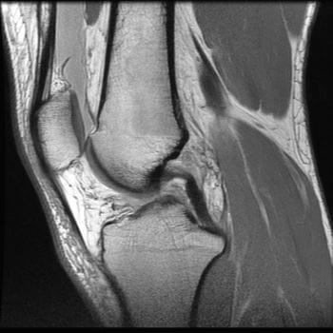
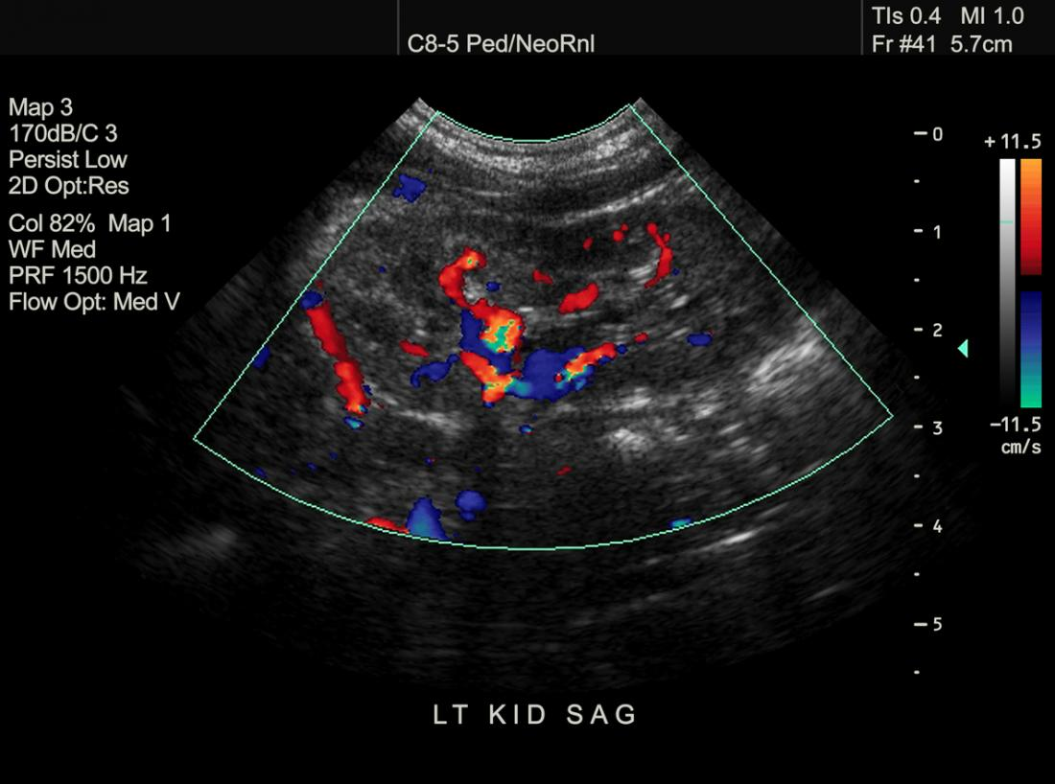
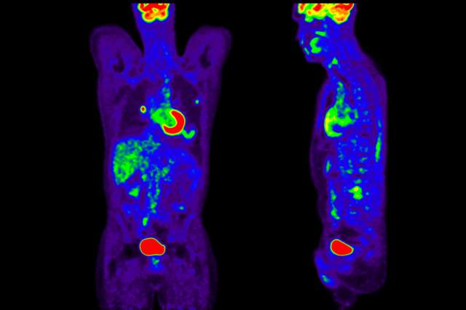
Magnetic Resonance Imaging (MRI) – uses radiofrequencies and magnetic fields to create high resolution imaging, especially of soft tissues, brain/spine, and joints
Ultrasound (US) – uses sound waves to visualize anatomy and acquire functional information (flow velocity of blood in vessels, etc.)
Nuclear Medicine (NM) – uses a special camera that can visualize radioactive pharmaceuticals that are injected into patients to determine cancerous or metabolic conditions

Slide 4
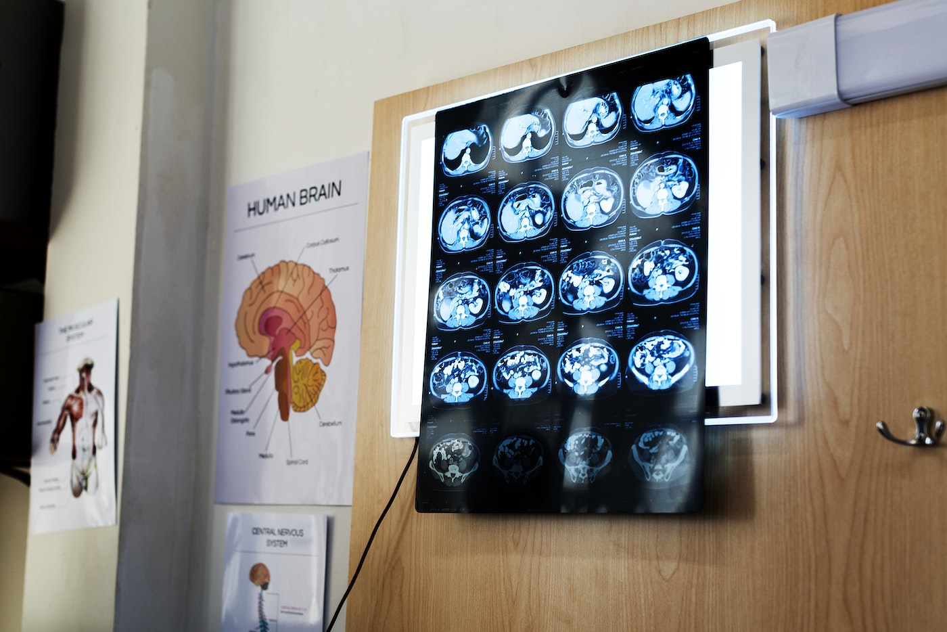
All of these modalities are generating a tremendous amount of data, 24 hours a day, 7 days a week, 365 days a year. How is it managed?
Up until approximately the late 1990s, imaging output was stored on film which was stored in files and was viewable on lightboxes. It was archaic, bulky, and inefficient
Patient files containing their entire imaging history had to be meticulously kept and manually retrieved for viewing by Radiologists
Film was made and processed with harsh chemicals
Just like physical mail was replaced by email, a digital transformation was in order for medical imaging. Digital modalities such as CT and MRI were coming into relevance, but different vendors had their own proprietary data formats, syntaxes, etc. A standard was needed to allow communication and storage (NEMA, 2023)

Slide 5
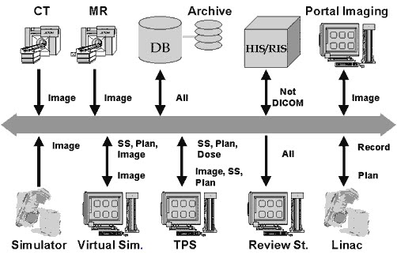
In 1993, the American College of Radiology and NEMA released the digital standard for medical imaging that persists today - Digital Imaging and Communications in Medicine (DICOM) which falls under the ISO-12052 standard (Marion, 2017)
DICOM supports:
Commands to move, store, and retrieve data
The semantics of file services, file formats and directories
Network operation
Message exchange
Data Dictionary
Web Services – DICOMWeb uses REST architecture and RESTful interfaces
Print services
Data formatting
Secure transfer via DICOM over TCP, port 104
This Photo by Unknown Author is licensed under CC BY-SA

Slide 6

DICOM files contain a lot more data than just image pixel information. The additional data must persist with the study and DICOM standardizes this process
DICOM SR (Structured Report) – when Radiologists read and dictate the exams, they often take measurements and make annotations on the images.
DICOM RT (Structure Set) – additional data overlaid on CT images for 3D Radiotherapy planning
DICOM Key Object Selection – Radiologists can flag certain images as “key” which can be referenced when reviewing images in future comparisons and may contain pathology, or planned biopsy locations, etc.
RDSR – Radiation Dose Structured Report is a DICOM encoding of the dose report generated at the modality and is tracked per compliance

Slide 7
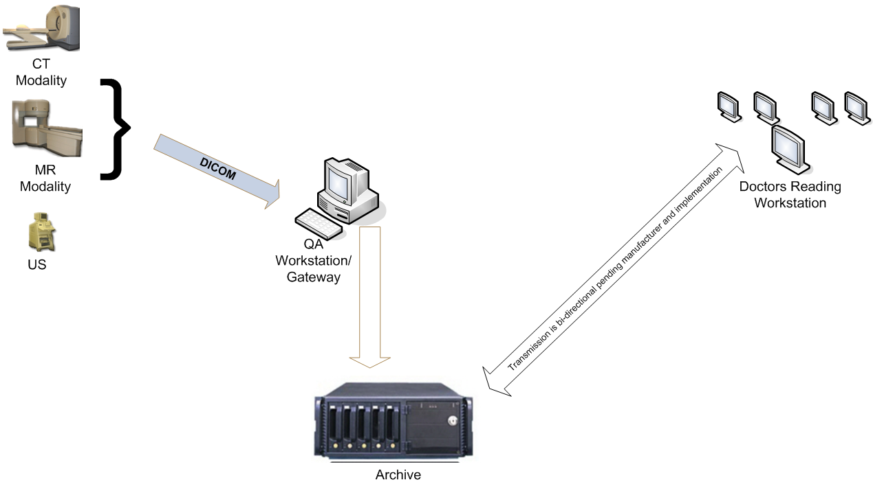
Digital imaging was given a technical means to communicate between multivendor devices through DICOM standardization, but… there still needed to be a software layer to store, present, and manage images with their associated reports and metadata. Enter PACS – Picture Archival and Communications in Medicine
PACS is a system made up of these DICOM compliant components:
The imaging modality devices (scanners, etc.)
The image archive – a PACS server
Diagnostic workstations that enable technologists and radiologists to manage the workflow
The connecting network

Slide 8
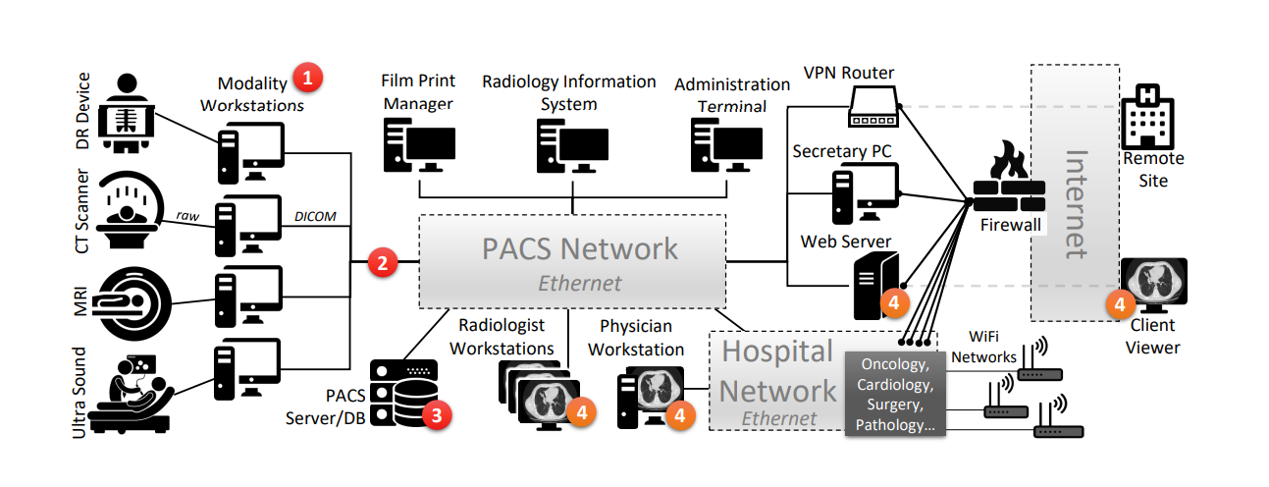
PACS systems work with DICOM to fully digitize Radiology data and workflows replacing film, plus allow for user concurrency and error handling Like other applications today, PACS can be configured on premises, in a hybrid set-up, or fully cloud based These systems are very customized to the adopting medical institutions needs. Most commonly, PACS handles all imaging modality data. “Mini-PACS” can be deployed for specific modalities, such as Nuclear Medicine and can offer additional specialized functionality. Large enterprises might even deploy a Federated PACS which can exist across many different sites

Slide 9

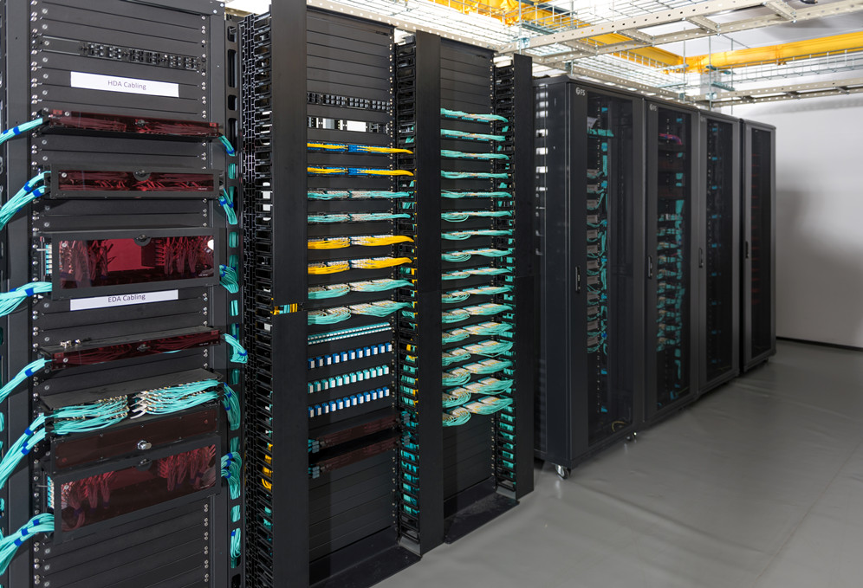
The storage network
The PACS server can be configured with storage in several different ways
DAS – Direct Attached Storage
NAS – Network Attached Storage
SAN – Storage Area Network
This Photo by Unknown Author is licensed under CC BY-SA-NC

Slide 10
So how much data are we talking here?
The average hospital is stacking up 50 petabytes of data per year!
This equates to 137 terabytes per day!
Medical Imaging is responsible for 80% of all clinical data!
This is largely unstructured data which isn’t as easy to manage as structured data – there is a constant effort to normalize and classify it so that analytics might be useful for business cases

Slide 11
Examples:
Exam | Average size
Chest X-ray | 15 Megabytes
CT scan | 235.6 Megabytes
MRI | 151 Megabytes
Ultrasound | 137.8 Megabytes
BTO (3D Breast Tomosynthesis) | 450 Megabytes
PET CT scan | 416.1 Megabytes
Digital Pathology (digitizing microscopic slides) | 3 Gigabytes!!!

Slide 12
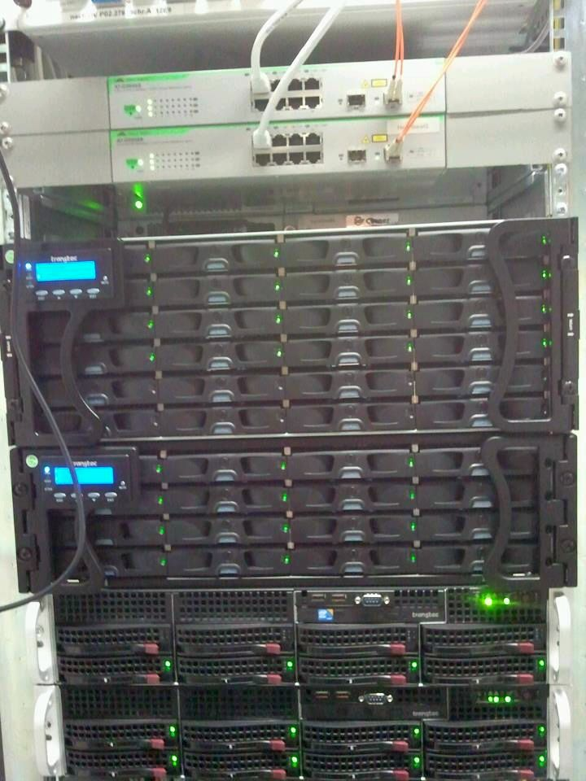
PACS-Server with 35-terabyte RAID Archive and high-speed fiber optic switch
By Hg6996 - Own work, CC0, https://commons.wikimedia.org/w/index.php?curid=17144461

Slide 13
PACS has reigned supreme as the go-to medical imaging jack-of-all functionality, but things are changing…enter the Vendor Neutral Archive (VNA)
DICOM imaging data isn’t the only data associated with a patient's diagnostic exam record anymore
Visible light images (photographs) are being collected in other areas of the hospital or in physician offices, such as: endoscopy, wound care, OB, etc.
Other previously non-recorded data, like EKG readouts can now be ingested
Internet of Things devices are producing data that can be collected (IV contrast injector exam data)
This information is being consolidated alongside DICOM imaging data to make up the VNA

Slide 14
VNA’s can: Store DICOM data, but can also encapsulate data with different formats into DICOM for storage and cohesiveness with DICOM processes, such as querying Provide information lifecycle management Enable choice of underlying database engine Facilitate administrative updates and corrections to stored exams Save money by stabilizing imaging data that has classically been migrated with PACS upgrades or vendor switches

Slide 15

The benefits of a VNA are…
Physicians can treat patients better because all of the data associated with the patients many distributed workups is all consolidated in one place. It used to be very difficult to see the big picture when to do so may have required logging into several systems and/or other medical institutions systems
Analytics can be employed on patient data since it’s all in one place and in a standardized format
Consolidated data equals central management and that cuts costs over managing several disparate systems

Slide 16
Now that we understand what’s happening in medical imaging, it’s important to understand how it connects to the rest of the hospital. Imaging is but one aspect of patient care and the over-arching information technology system is the Electronic Medical Record (EMR)
The Electronic Medical Record is the main hub that all hospital departments managing patient care work through. There are subcomponents of this EMR for different patient care areas (Radiology, Surgery, Gastroenterology, Cardiology, Billing, etc. etc.)
The medical imaging component of the EMR is the Radiology Information System (RIS) which manages the imaging data archives, image orders, record-keeping, and billing.

Slide 17
Communication between EMR subcomponents is done via a standard called Health Level 7 (HL7) which was developed for the same reasons DICOM was, to facilitate communication between disparate software systems allowing patient care.
“A set of international standards for the exchange, integration, sharing, and retrieval of electronic health information that supports clinical practice and management, delivery, and evaluation of health services” (Radiology Key, n.d.)
“7” is a reference to the Application Layer in the OSI model where these transmissions occur over HTTP. SFTP and FTPS can be used to securely send these transmissions
HL7 as had several revisions, and the latest version is HL7 FHIR (fire) – Fast Health Interoperability Resources and is based on RESTful interfaces using APIs and openstandard file formats such as XML or JSON to store and exchange data

Slide 18
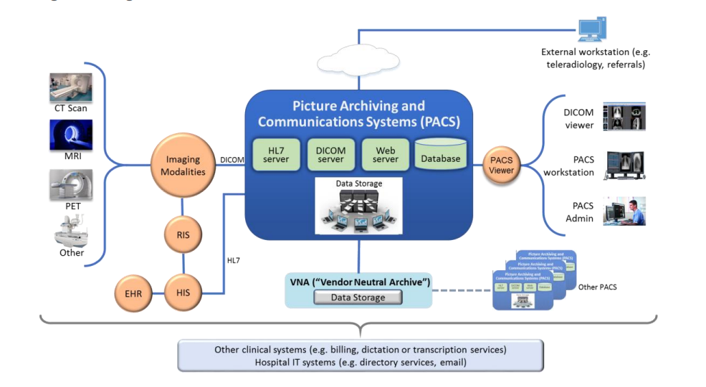

Slide 19
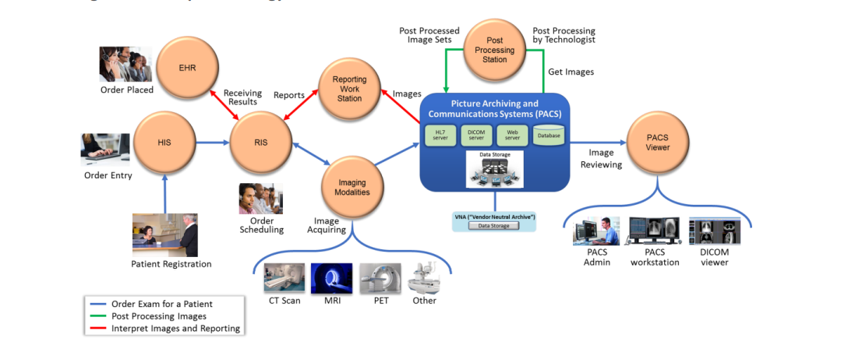

Slide 20
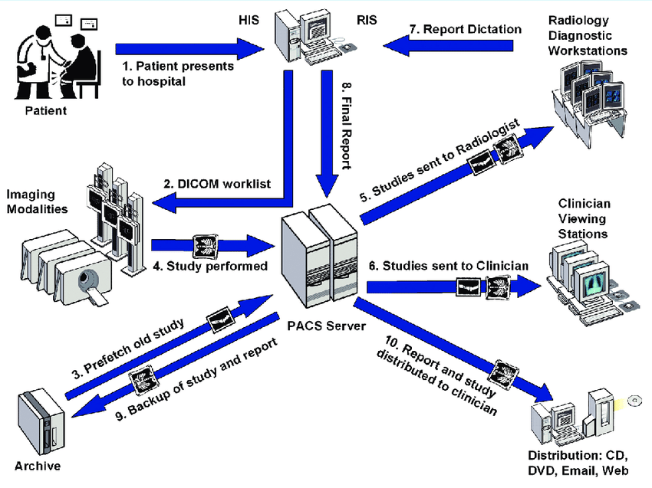

Slide 21
The future
“Enterprise Imaging” is a broader framework being adopted by large medical institutions that incorporates all aspects of imaging and consolidates indexes, manages, stores, distributes, views, exchanges, and analyzes imaging and multimedia content for the EMR. It allows one enterprise to share large banks of data with other enterprises for training, research, AI, etc (DICOM Systems, n.d.).
Cloud architectures are being incorporated more and more
A.I. (of course) – algorithms are already being employed for reading chest x-rays and mammograms. They are more accurate than humans for detecting certain pathologies and can work much faster too.

Slide 22
Modern model for archive and access is the cloud computing/server side rendering/thin client set-up:
The thin client is a zero-footprint HTML-5 viewer that accesses the on-line server
The processing is performed at the server and only the results are presented on the thin client
This reduces network bandwidth of the hospital network because data only needs to be sent to the archive once and the data doesn’t have to be pushed back out to independent thick client workstations

Slide 23
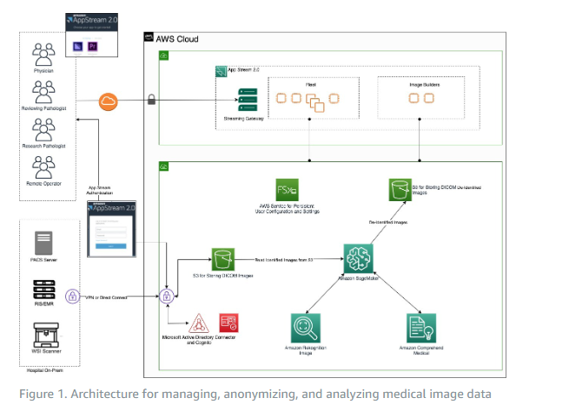
An AWS architecture for pulling in DICOM images, anonymizing them, using analytics/machine learning services on the data, and then storing the results. AWS Comprehend Medical and Amazon Rekognition identify and remove patient information. Amazon SageMaker is the machine learning platform used to build models. AWS Appstream 2.0 allows users to access the setup from anywhere

Slide 24
As medical imaging continues to evolve, the data demands will only increase Imaging capabilities continually get more advanced and that usually equals higher resolution, more advanced post processing, and new technology (AI, etc.)– this is all added to the size of the files. How big are these archives going to be in 30 years?

Slide 25
Thanks for Listening
Any Questions?

Slide 26
References:
Dicom Systems. (n.d.). What is Enterprise Imaging? Dicom Systems. https://dcmsys.com/project/what-is-enterprise-imaging/
Vendor Neutral Archive. (2023, August 28). In Wikipedia. https://en.wikipedia.org/wiki/Vendor_Neutral_Archive
Charles, M. (2018, August). PACS (picture archiving and communication system). TechTarget. https://www.techtarget.com/searchhealthit/definition/picture-archiving-and-communication-system-PACS
Marion, J. (2017, July 31). What makes up a medical imaging system? TechTarget. https://www.techtarget.com/searchhealthit/feature/What-makes-up-a-medical-imaging-system?_gl=1*1okdryv*_ga*NzAyNzM4MDUwLjE2OTQ5NDkxNzE.*_ga_TQKE4GS5P9*MTY5NzM2NzA2NS4zLjEuMTY5NzM2NzA3MC4wLjAuMA..&amp;_ga=2.144928054.328991854.1697281633-702738050.1694949171
American Board of Imaging Informatics. (2023). About Imaging Informatics. ABII. https://www.abii.org/About-Imaging-Informatics.aspx
drezzo. (2021). Medical Imaging Informatics. Radiology Key. Advance online publication. https://radiologykey.com/medical-imaging-informatics/
DICOM/ About/ Key Concepts. (n.d.). DICOM Standard.org. https://www.dicomstandard.org/concepts
By Hg6996 - Own work, CC0, https://commons.wikimedia.org/w/index.php?curid=17144461
Eastwood, B. (2023, May). How to Navigate Structured and Unstructured Data as a Healthcare Organization. HealthTech, Article 2023/05. https://healthtechmagazine.net/article/2023/05/structured-vs-unstructured-data-in-healthcare-perfcon
Fuller, C. [Chris Fuller], Kaur, H. [Harleen Kaur], & Shetty, P. [Prashad Shetty]. (2021, June 17). Using AppStream 2.0 to Deliver PACS and Image Analysis in Clinical Trials. AWS Architecture. https://aws.amazon.com/blogs/architecture/using-appstream-2-0-to-deliver-pacs-and-image-analysis-in-clinical-trials/
Levy, M., Amit, G., Elovici, Y., & Mirsky, Y. (2022, January). The Security of Deep Learning Defenses for Medical Imaging. In ResearchGate (Vol. 358145189). researchgate.net.
UCLA Health (n.d.). Nuclear Medicine[Photograph]. UCLA Health. https://www.uclahealth.org/medical-services/nuclear-medicine
Medical News Today (2017).Ultrasound[Photograph]. Medical News Today. https://www.medicalnewstoday.com/articles/245491#Safety
Jacobson, J.(2022). Magnetic Resonance Imaging (MRI) of the knee[Photograph]. Merck Manual. https://www.merckmanuals.com/home/special-subjects/common-imaging-tests/magnetic-resonance-imaging-mri
Richman Photo/Shutterstock(2023). X-ray Barium Enema[Photograph]. News-Medical. https://www.news-medical.net/health/Fluoroscopy-Procedure.aspxSt.
Joseph’s Regional Medical Center (2023). CT Scan Image[Photograph]. USA.United-Imaging. https://usa.united-imaging.com/products/computed-tomography
Harrison, D.(2023). Lumbar Spine X-ray [Photograph]. SpineInfo. https://www.spineinfo.com/diagnostics/x-ray/x-ray/
Schultze, OC & Greyling, Jaco & Hayes, M & Andronikou, Savvas. (2007). Talking PACS: Part 1 - What is PACS?. South African Journal of Radiology. 11. 10.4102/sajr.v11i3.31.
Cawthra, J, Littlefield, K, Niemeyer, R, Wang, S, & Zheng, K (2018). SECURING PICTURE ARCHIVING AND COMMUNICATION SYSTEM (PACS). JNCCoE; NIST. https://www.nccoe.nist.gov/sites/default/files/legacy-files/hit-pacs-project-description-final.pdf

